Slide 1

PYTHON FUNDAMENTAL MASTERCLASS
Kickstart TO LEARNING PYTHON
AND
STEP BY STEP SYLLABUS

Slide 2
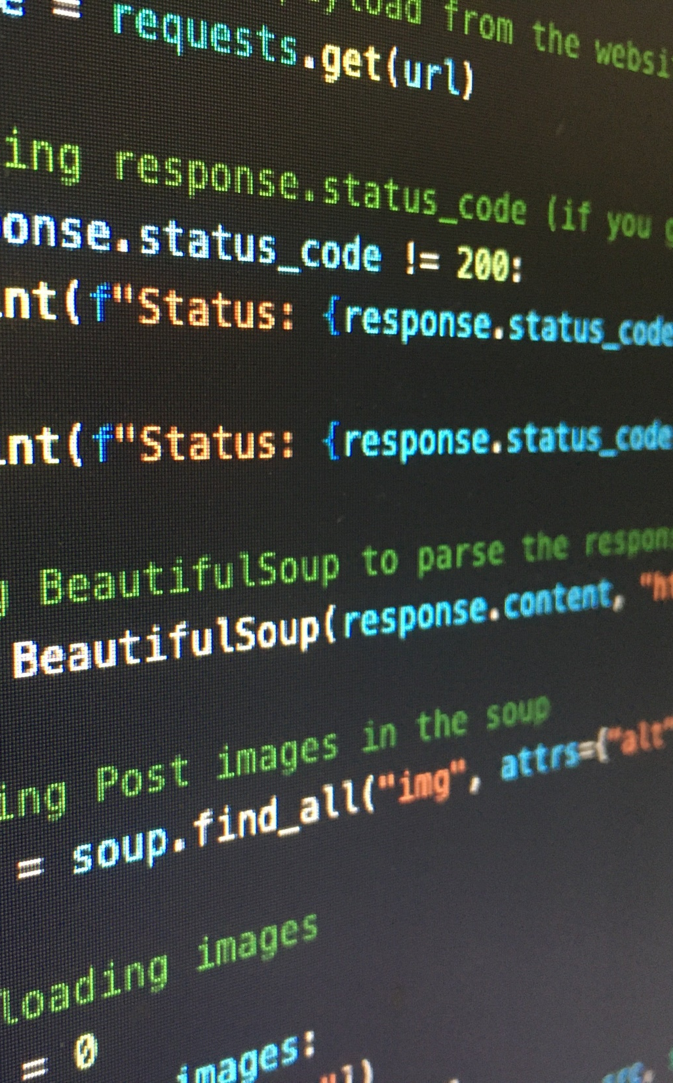
Introduction and basics
Introduction
Interpreter vs. Compiler
Understanding and Getting to Know Python
More on Variables and Strings String Formatting
Displaying Numbers, Variables and Strings

Slide 3
Program flow control
Conditions with IF ELIF ELSE
FOR Loops
Understanding CONTINUE and BREAK
Augmented Assignments
WHILE Loops
Nesting Conditions and Loops

Slide 4
Understanding sequences
Lists in Python
Understanding Iterators
Using Ranges
Ordered Sets Using Tuples
Binary and Hex Numbers in Python

Slide 5
Understanding mappings
Dictionaries and More
Sets in Python

Slide 6
Handling files, Input and output
Reading and Writing Text Files
Appending to Files
Writing Binary Files Manually
Using PICKLE to Write Binary Files
Shelves
Manipulating Data with Shelves
Updating With Shelves

Slide 7
Modules and functions – P1
Modules and Import
Standard Python Library
Time and Date in Python
Timezones and PYTZ
Checking Path
Functions in Python
Scope in Functions
Global Variables

Slide 8
Modules and functions – P2
Importing Techniques
Underscores in Python
Namespaces
Recursion
Nonlocal
LEGB

Slide 9
Exceptions
Reviews
Handling Exceptions
Raising Exceptions
Customising Exceptions

Slide 10
Object oriented programming – P1
OOP and Classes
Instances, Constructors, Self and More
Class Attributes
Methods
Non Public and Mangling
DocString and Raw Literals
Compile Time
Getters and Properties

Slide 11
Object oriented programming – P2
Getters and Setters
Encapsulation
Inheritance
Subclasses and Overloading
Calling Super Methods
Overriding Methods
Polymorphism
Duck Test

Slide 12
Object oriented programming – P3
Composition
Aggregation
Delegation
Abstract Classes and Interfaces

Slide 13

NOTES
WEBSITES
Prerequisites
www.python.org
www.realpython.com
None
TEXTS
Python Basics – ISBN: 9781775093329
Suggested Time
60 Hours

Slide 14

Document History
Author | Version | Revision | Date / Time | Department | Validity
Mehdi Shokri | 1.0.0 |  | 11-05-2023 | Development | 3 Months
Mehdi Shokri |  | 1.0.1 | 16-05-2023 | Development | 3 Months

